Slide 1

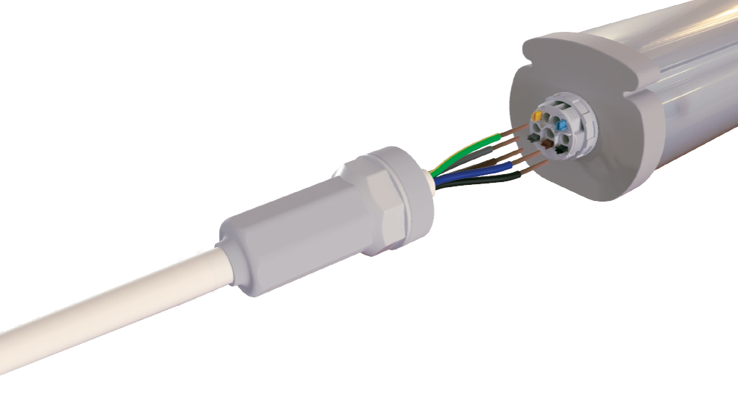
LCS 75 – SMART IP66 connection
new: 5 pole variant
© blas / Fotolia
1

Slide 2
LCS 75 – light for sure
Fast connection for ip66 water-proof luminaires
High Protection
IP66 Code
Time Saver
extremely quick connection of water-proof luminaires – less than 5 minutes
no need to open the luminaire
© blas / Fotolia

Slide 3
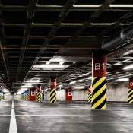
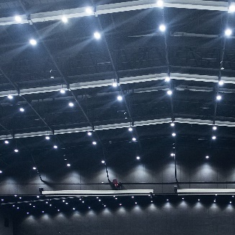
Scope of application
LCS 75 – smart IP66 connection
Moisture-proof luminaires
Industrial lighting

Slide 4
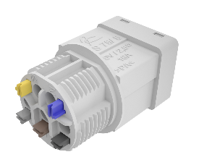
DESIGN
LCS 75 – smart IP66 connection
terminal main body with:
spring terminals
opening-/release keys
terminal main body housing
lock nut M20 or M25
(moulded) sealing to luminaire
cable support sleeve
sealing to cable with moulded sealing grommet
NEW:
5 pole variant M25

Slide 5
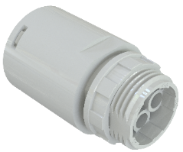
Technical Details
LCS 75 – smart IP66 connection
Wire connection
Internal connection
1 x 0.5 – 1.5 mm² solid
1 x 0.5 – 2.5 mm² solid
External connection
1 x 0.5 – 2.5 mm² solid or flexible
External connection with opening/release key for
easy access
Pre-installed terminal block inside the luminaire housing
M20 dia, 3 pole
Under develoment: M20 5 pole without keys
M25 dia, 3 pole and 5 pole
Quick. Safe. Cost effective..

Slide 6
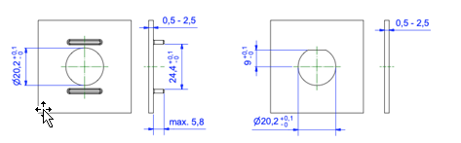
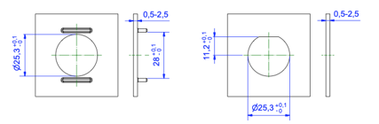
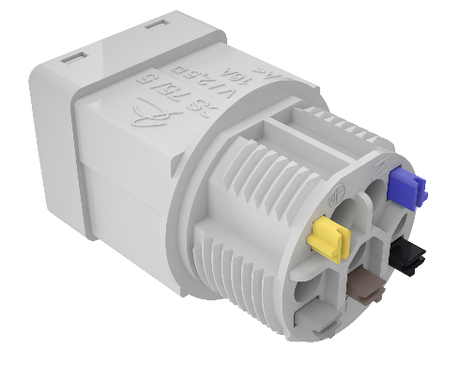
MOUNTING concEPT
Lcs 75 – smart IP66 connection
LCS 75 Inside View
fastening of the terminal main body from the outside by locking nuts M20 (3-pole), M25 (5-pole)
two possibilities of anti-twist protection
© blas / Fotolia

Slide 7

mounting concePT
Lcs 75 – smart IP66 connection
LCS 75 Outside View
fastening of the lock nut by a special tool
fastening of the cable support sleeve by special tools SW 24 (3 pole), SW 30 (5 pole)
2K moulding with moulded seals to housing and cable (no separate seals are required)
cable diameter
7.5 – 12.5 mm (3 pole),
9 – 13.6 (5 pole)
cable easily inserted through a sealing grommet
Tool
© blas / Fotolia

Slide 8
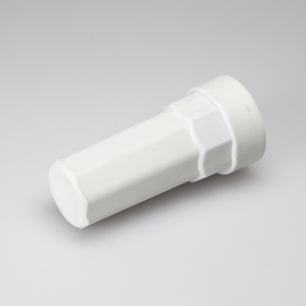
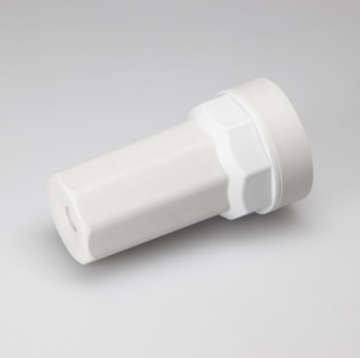
ABK 75: protective caps (accessory)
Lcs 75 – smart IP66 connection
ABK 75/ 3 and
ABK 75/ 5
closed support sleeve as protective cap on the final through-wired luminaire
mounting of protective caps by standard tools SW 24 (3 pole), SW 30 (5 pole)
ABK 75/ 3
ABK 75/ 5
© blas / Fotolia

Slide 9
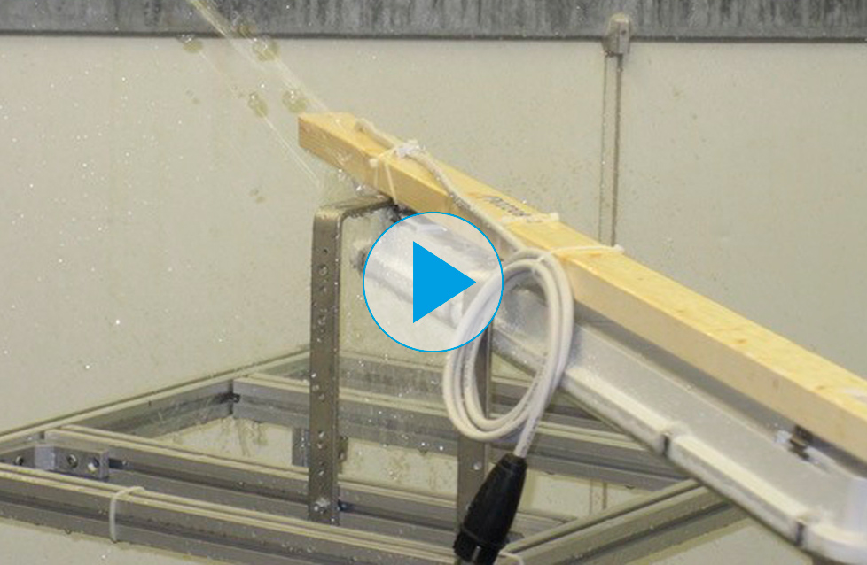
Ip code testing
Lcs 75 – smart IP66 connection
IP code 66
protection against powerful water jets (12.5 mm nozzle)
test duration: at least 3 minutes
water volume: 100 litres per minute
pressure: 100 kPa at a distance of 3 m
High protection. Smart connection.

Slide 10
Technical data 3 pole M20
LCS 75 – smart IP66 connection
General
nominal cross section: 2,5 mm²
voltage rating: 250 V
mouldings polyamide: 6/6, grey, TPE grey
contacts copper and spring steel, plated
current rating to EN 60998: 16 A at 40 °C
IP Code
IP66
test report according to EN 60598-1, section 9.2.2
Fixing to luminaire housings M20
wall thickness 0.5 – 2.5 mm
maximum torque for lock nut and support sleeve: 0.7 Nm
Connection
external: 1 x 0.5 – 2.5 mm² solid or flexible
internal: 1 x 0.5 – 1.5 mm² solid
1 x 0.5 – 2.5 mm² solid
Cable diameter
7.5 to 12.5 mm
External
dismantling length: 69 mm (PE), 60 mm (L+N)
stripping length: 17 mm
Internal
stripping length: 12 mm

Slide 11
Technical data 5 pole M25
LCS 75 – smart ip66 connection
General
nominal cross section: 2,5 mm²
voltage rating: 400 V
mouldings polyamide: 6/6, grey, TPE grey
contacts copper and spring steel, plated
current rating to EN 60998: 16 A at 40 °C
IP Code
IP66
test report according to EN 60598-1, section 9.2.2
Fixing to luminaire housings M25
wall thickness 0.5 – 2.5 mm
maximum torque for lock nut and support sleeve: 1.0 Nm
Connection
external: 1 x 0.5 – 2.5 mm² solid or flexible
internal: 1 x 0.5 – 1.5 mm² solid
1 x 0.5 – 2.5 mm² solid
Cable diameter
9.0 to 13,6 mm
External
dismantling length: 69 mm (PE), 60 mm (L+N)
stripping length: 17 mm
Internal
stripping length: 12 mm

Slide 12
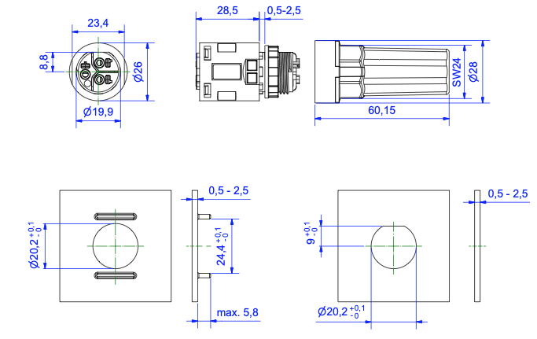
dimensions 3 pole M20
LCS 75 –smart IP66 connection

Slide 13
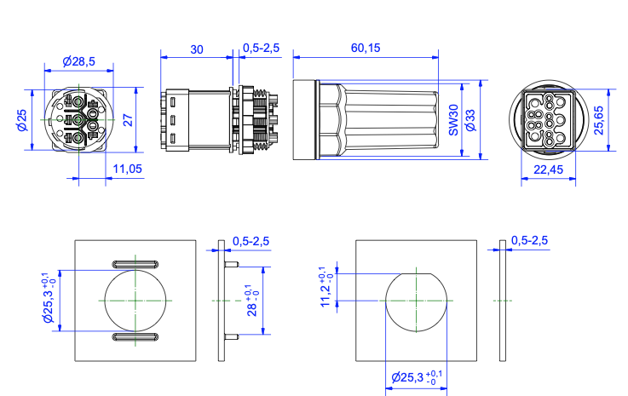
Dimensions 5 pole M25
LCS 75 –smart IP66 connection

